Slide 1
Ideation Phase

Slide 2
Context Summary – Idea 1
Riders under the influence of alcohol are one of the leading causes of two-wheeler accidents. This idea integrates an MQ3 alcohol sensor inside the helmet to detect alcohol before ignition.

Slide 3
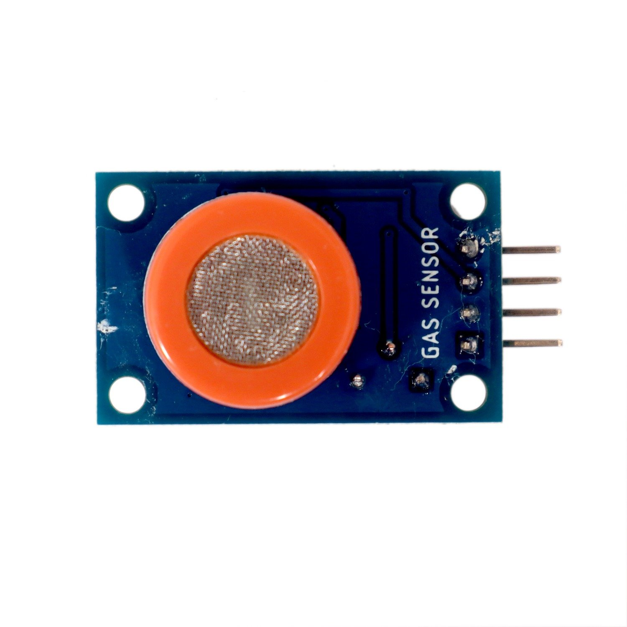
Key Features
Feature 1 :
MQ3 Alcohol Sensor – Detects alcohol in rider’s breath.

Slide 4
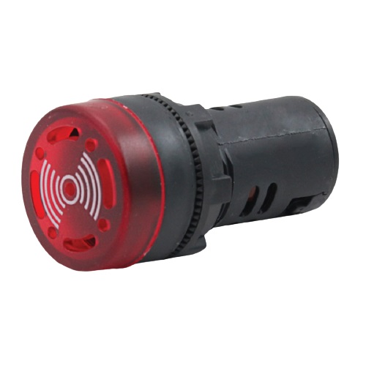
Key Features
Feature 2 :
LED/BUZZER – Indicates bike from starting if alcohol is detected.

Slide 5
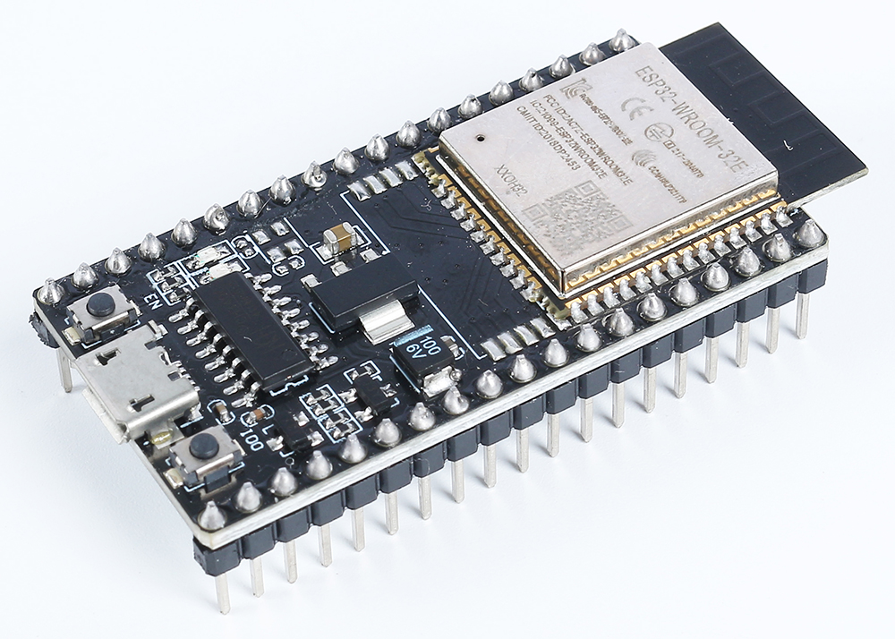
Key Features
Feature 3 :
ESP32 Processing – Processes data and triggers alert.

Slide 6
Value Proposition
Prevents drunk driving accidents.
Saves lives and reduces police monitoring burden.
Creates accountability for riders.

Slide 7
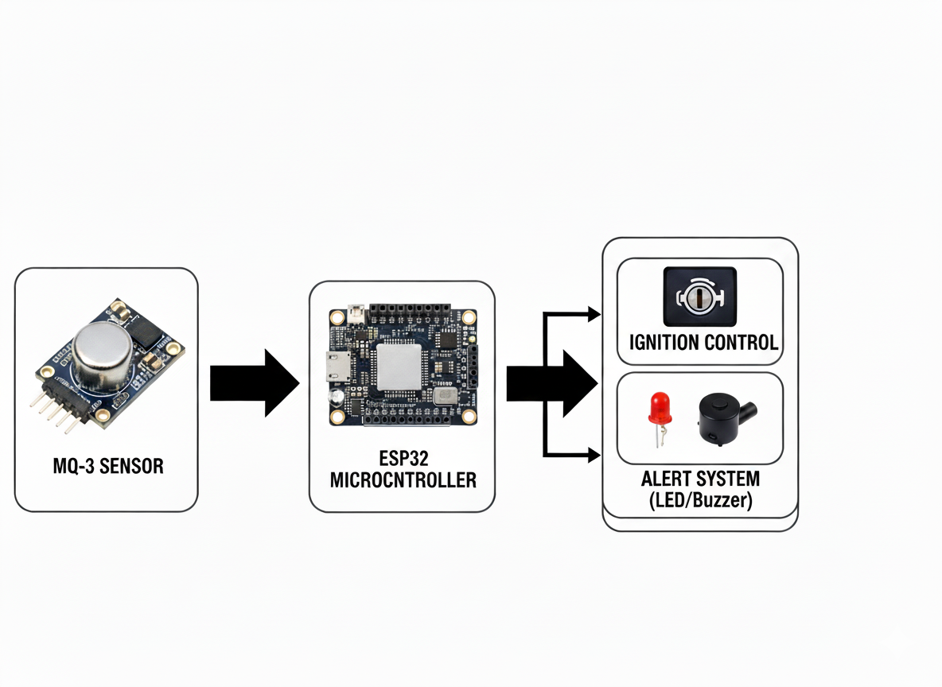
Block Diagram

Slide 8
Context Summary – Idea 2
Long rides and night driving often cause drowsiness, leading to accidents. This idea introduces fatigue sensors (eye blink / heart rate monitoring) to alert the rider before losing focus.

Slide 9
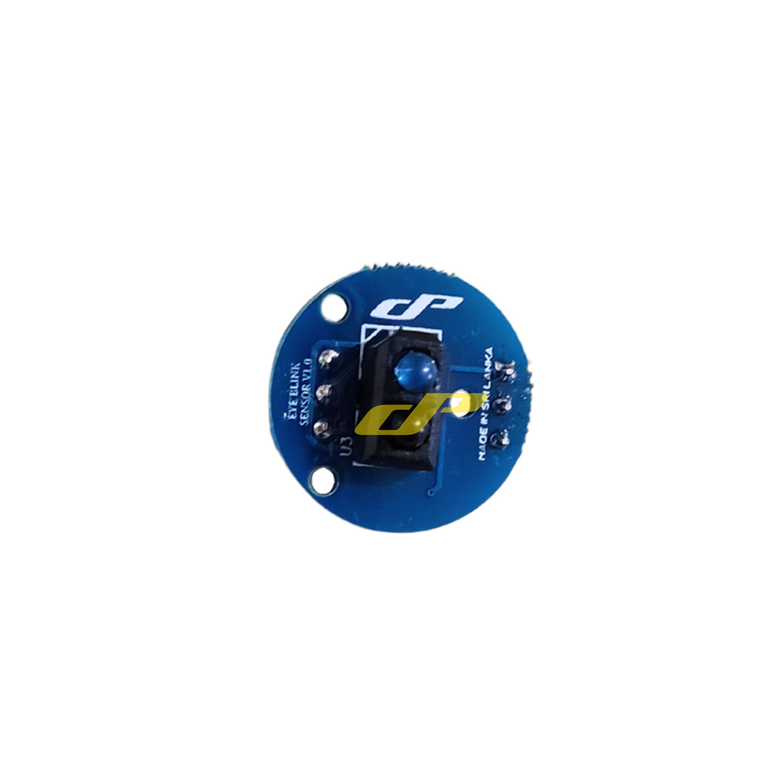
Key Features
Feature 1 :
IR Eye Blink Sensor – Detects abnormal eye closure rate.

Slide 10
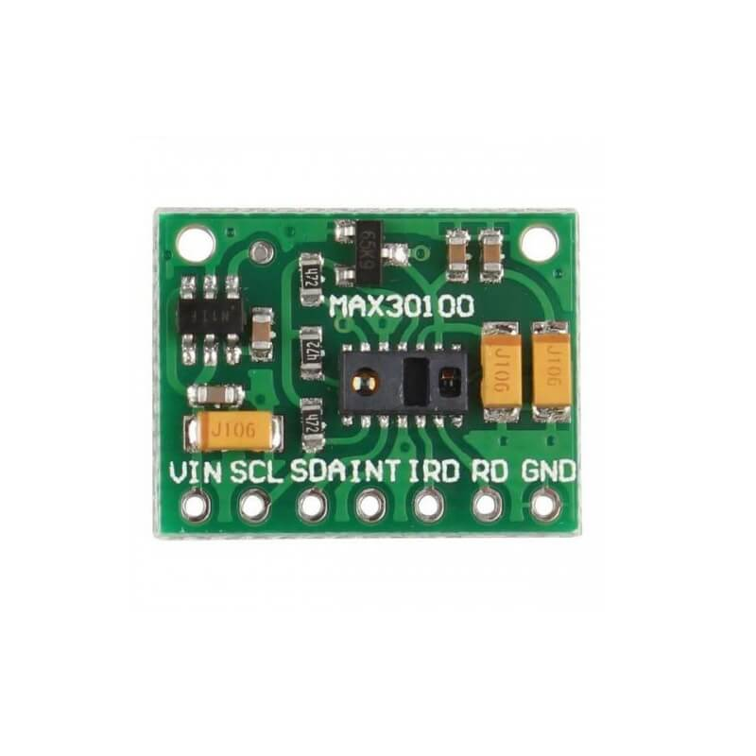
Key Features
Feature 2 :
Heart Rate Sensor – Tracks abnormal pulse indicating drowsiness.

Slide 11
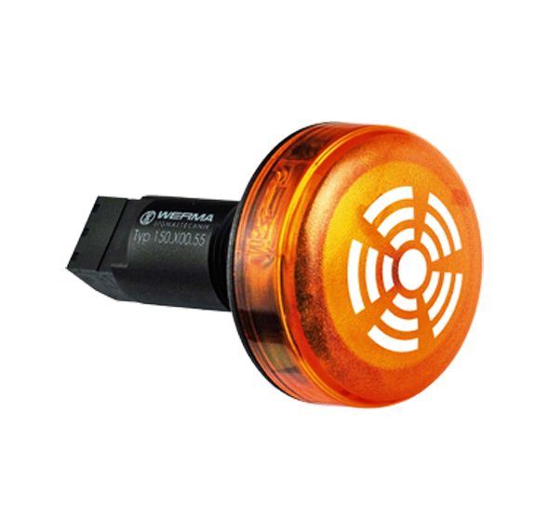
Key Features
Feature 3 :
Buzzer/LED Alert – Gives immediate warning to rider.

Slide 12
Value Proposition
Prevents sleep-related road accidents.
Keeps rider attentive during long rides.
Affordable and non-intrusive monitoring.

Slide 13
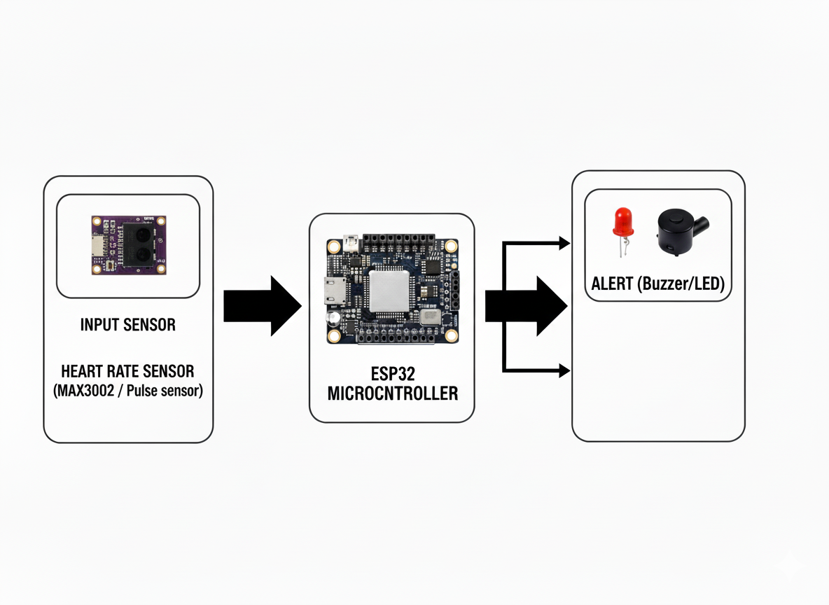
Block Diagram
Digital Displays (IoT signage)

Slide 14
Context Summary – Idea 3
In remote or highway accidents, victims often fail to get timely help. This idea integrates crash detection and GSM/GPS-based emergency alerts for instant response.

Slide 15
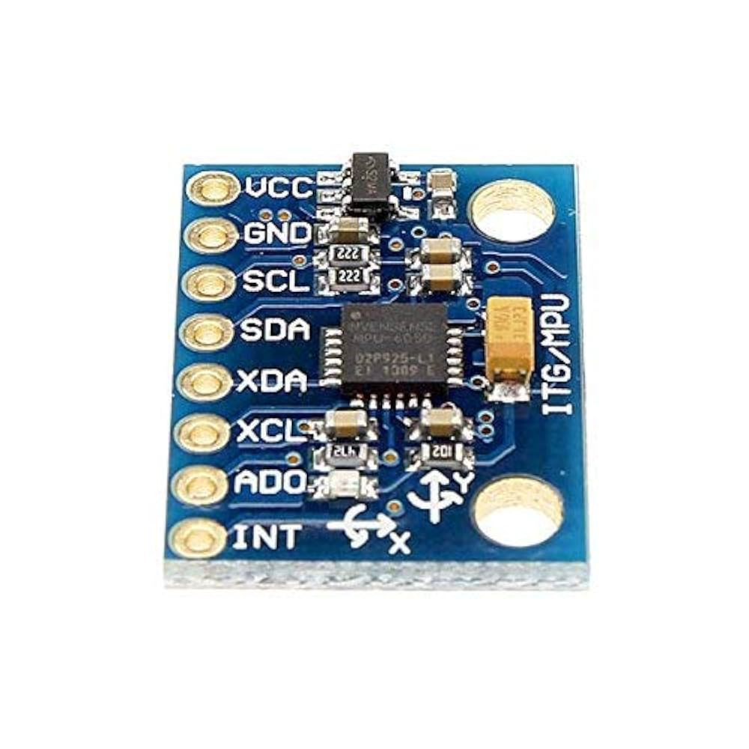
Key Features
Feature 1 :
MPU6050 (Accelerometer + Gyroscope) – Detects crash or fall.

Slide 16
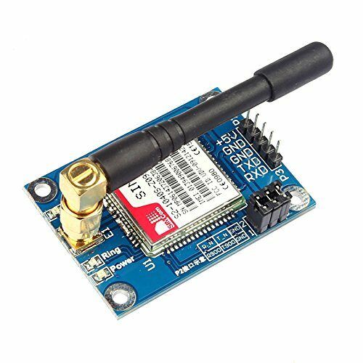
Key Features
Feature 2 :
GSM Module – Sends SMS alert to family/hospital.

Slide 17
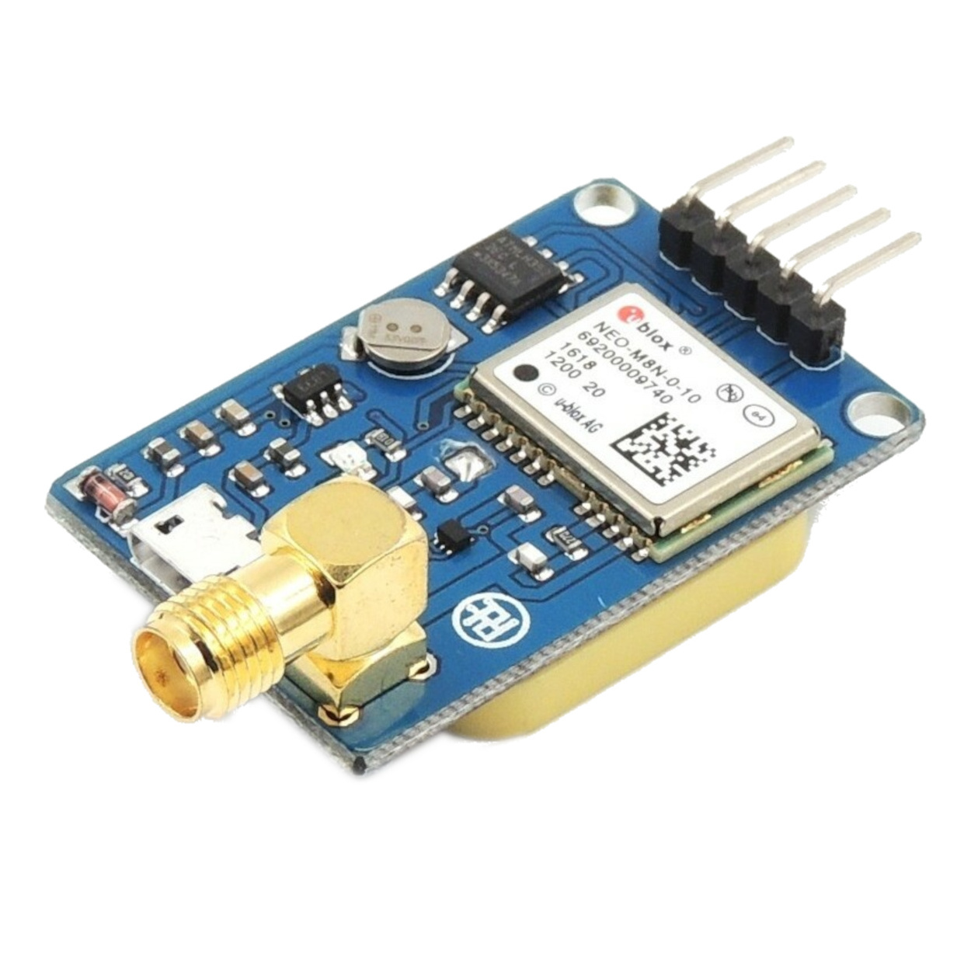
Key Features
Feature 3 :
GPS Module – Shares real-time accident location.

Slide 18
Value Proposition
Ensures instant emergency support after an accident.
Helps families & hospitals respond faster.
Increases survival chances by reducing response delay.

Slide 19
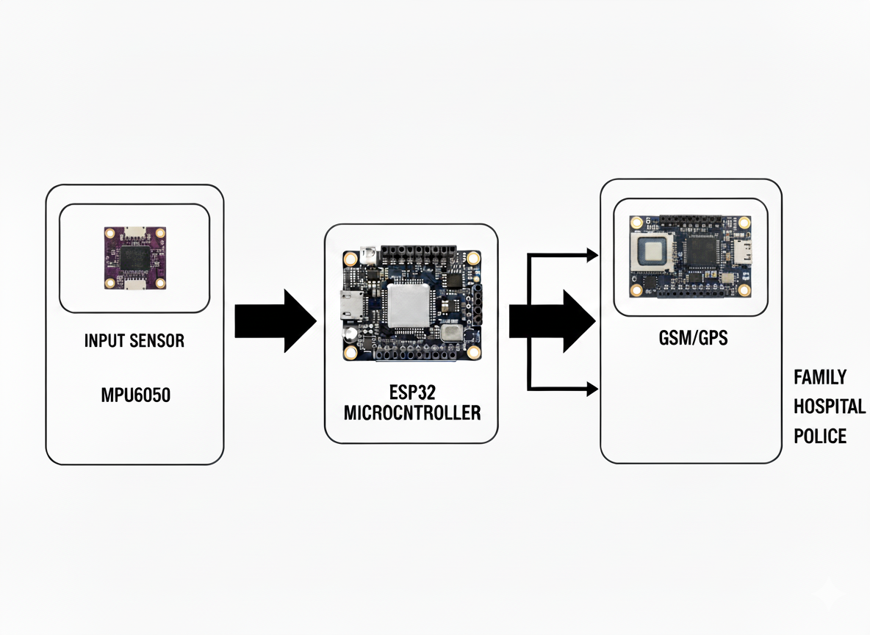
Block Diagram
Digital Displays (IoT signage)

